Slide 1
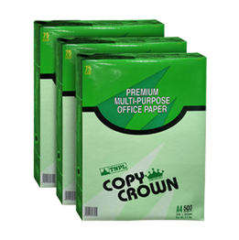
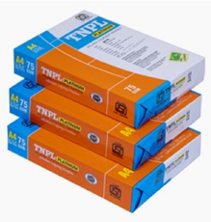
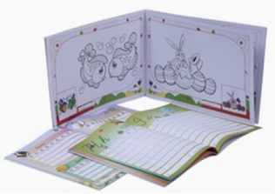
TAMIL NADU NEWSPRINT AND PAPERS LIMITED

Slide 2
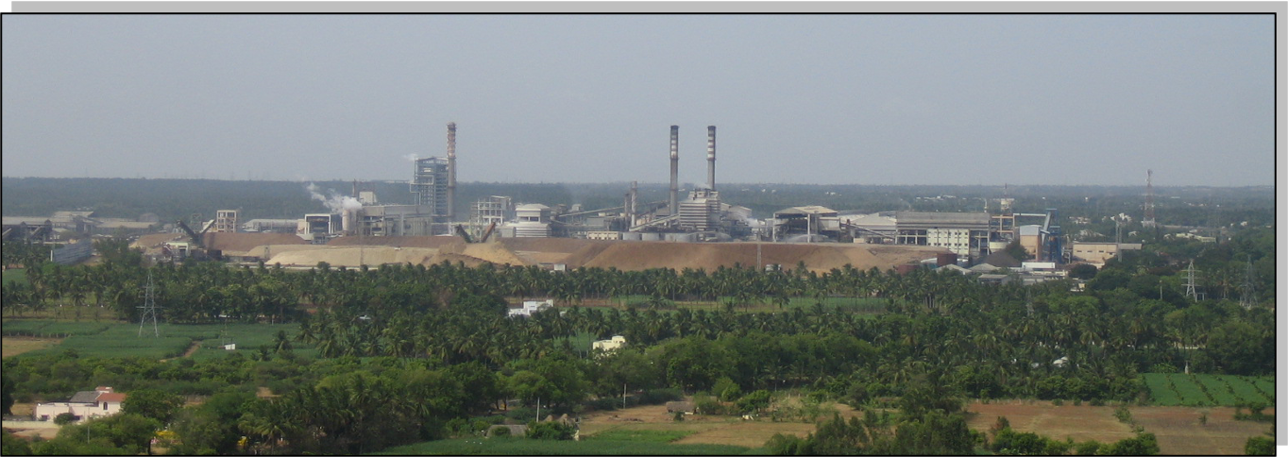
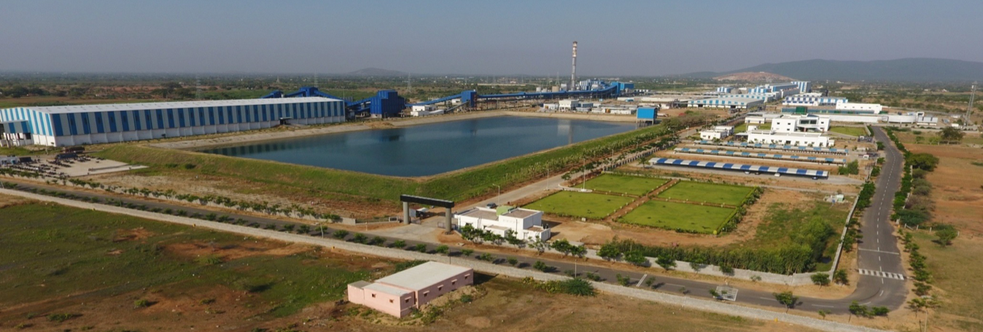
Mill View
Unit I - Karur District
Unit II - Trichy District

Slide 3
Shareholdings as on 31.03.2023

Slide 4
Overview
Promoted by Government of Tamilnadu to manufacture paper using bagasse as primary raw material
Grown from an initial capacity of 90,000 tpa to 600,000 tpa between 1985 and 2016 in five stages.
Hard wood, bagasse and Deinking Pulping capacity increased from 275 tpd to 1580 tpd between 1985 and 2022.
TNPL is self sufficient in captive power and operates a 103.62 MW power plant in Unit I and 50 MW in Unit II
Largest bagasse based paper mill in the World. Consumes 14 lakh MT bagasse per annum and Only plant in country to make excellent quality Writing and Printing and Copier paper with predominantly Bagasse pulp and Deinked pulp
India’s largest exporter of Printing & Writing paper. Exports about 1/5th of production to over 30 countries across the globe.
Only Indian company which has a waste management plant with a cement plant (LSFM) to mitigate environmental impact.

Slide 5
Growth in Paper/Board & Pulp Production capacity
3 PMs + BM4(Greenfield)
1580
PM#1 + PM#2 + PM#3
PM’s Rebuild +
ECF Pulp
PM’s Rebuild
PM #1 + PM#2
PM#1
275
2022 : Commenced production from 400 tpd Hard Wood pulp plant at Unit II

Slide 6
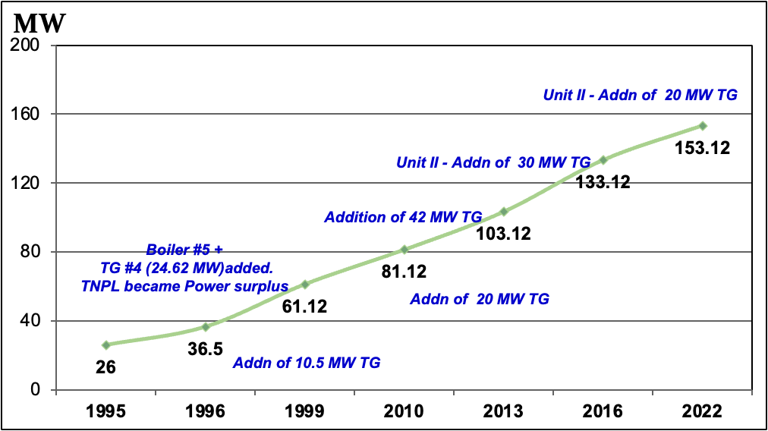
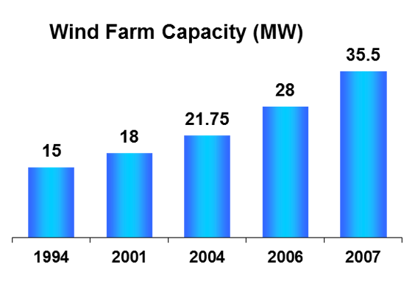
Growth in Power Generation
Captive Power Generation
Wind Farm
Green Energy
Wind power is exported to the State grid.

Slide 7
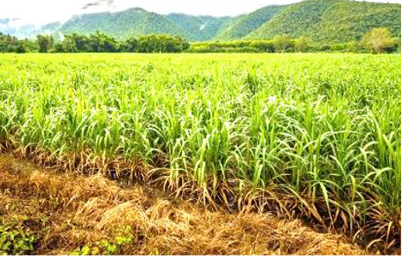
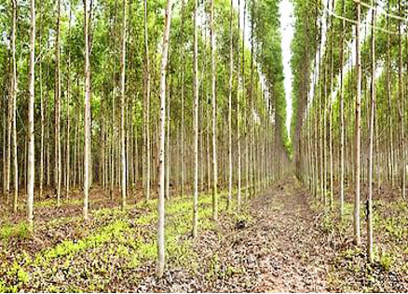
Growth in Plantation
Plantation activity started in 2004-05, to augment pulpwood supplies. Raised pulpwood plantation in 2.11 lakh acres through Farm Forestry and Captive Plantation schemes
Through afforestation schemes TNPL is the first company in the country to procure about
2.1 million MT of pulpwood directly from farmers
A proactive measure to augment pulpwood supplies
Operating a Clonal Propagation and Research Centre with a production capacity of 55 million plants per annum. TNPL provides high-yielding clones/seedlings at subsidized rates to farmers.
TNPL generated, employment of about 4 million man-days contributing to the socio-economic welfare of the farming community.

Slide 8
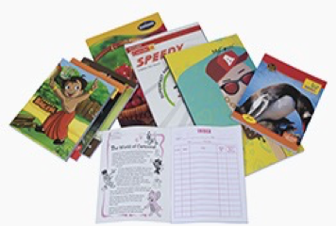
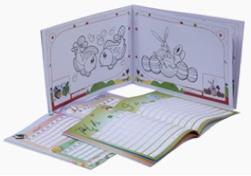
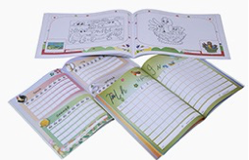
Marketing - Unit I - Writing and Printing Paper
•Radiant Printing (RDS)
•Hi-tech Maplitho
•Elegant printing
PM I
PM II
•Eco - Maplitho
•Ace Marvel
•Radiant printing (Platinum)
•Print Fine
•Pigment printing
•Copier papers
PM III
TNPL markets its products throughout the country through well established marketing network. Exports about 20% of its products to over 30 countries across the globe.
Markets 25% of sales to direct parties like TN Textbook, Kerala Textbook, Andhra Textbook, Telangana Textbook
TNPL also markets premium quality note books in Tamil Nadu.

Slide 9
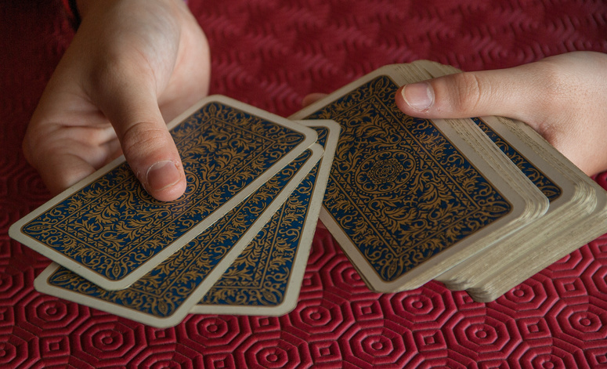
Marketing - Unit II - Multilayer Coated Boards
Variety of Products
Making 100% virgin fibre based premium packaging boards
Folding Box Board (FBB)
Solid Bleached Sulphate Board (SBS)
Cup stock
TNPL Boards are Industry leaders in quality

Slide 10
Performance Highlights For Q4 FY23 and FY23
TNPL achieved highest ever Turnover, EBIDTA, PBT and PAT since inception during FY23 and
Highest ever Turnover, EBIDTA, PBT and PAT compared to all the preceding Q4 since inception.
Compared to Q4FY22
Turnover up by 4%
EBIDTA up by 128%
Compared to FY22
Turnover up by 28%
PBT up by 384%
Cash Profit up by 158%
PAT up by 358%
EBIDTA up by 157%
Cash Profit up by 246%
PBT up by 2640%
PAT up by 2608%

Slide 11
Financials for Q4 FY23 and Q4 FY22
Particulars | UOM | Q4 FY23 |  |  | FY23
 |  | 2022-23 | 2021-22 | Growth | 2022-23 | 2021-22 | Growth
Sales Volume | MT | 158125 | 205555 | -23% | 588150 | 622624 | -6%
- Paper | " | 116973 | 158640 | -26% | 420793 | 438079 | -4%
- Board | " | 41152 | 46915 | -12% | 167357 | 184546 | -9%
Total Revenue | Rs Cr | 1440 | 1388 | 4% | 5225 | 4069 | 28%
EBITDA | " | 288 | 126 | 128% | 1048 | 407 | 157%
Cash profit | " | 232 | 90 | 158% | 866 | 251 | 246%
PBT | " | 163 | 34 | 384% | 603 | 22 | 2640%
PAT | " | 103 | 22 | 358% | 388 | 14 | 2608%
EBITDA Margin | % | 20% | 9% |  | 20% | 10%
PBT Margin | % | 11% | 2% |  | 12% | 1%
PAT Margin | % | 7% | 2% |  | 7% | 0.4%

Slide 12
Operational & Marketing – Performance

Slide 13
Profitability

Slide 14
5 Years - Financial Highlights
Particulars | UOM | 2018-19 | 2019-20 | 2020-21 | 2021-22 | 2022-23
Production | MT | 609570 | 565026 | 495300 | 572651 | 588829
Sales | MT | 622436 | 549893 | 469522 | 622624 | 588150
Operating Results
Total Income | Rs Cr | 4122 | 3509 | 2819 | 4069 | 5225
Operating Profit (EBITDA) | " | 615 | 644 | 330 | 407 | 1048
Cash Profit (PBDT) | " | 382 | 422 | 137 | 251 | 866
Profit / (Loss) Before Tax (PBT) | " | 155 | 191 | -99 | 22 | 603
Profit / (Loss) After Tax (PAT) | " | 94 | 130 | -65 | 14 | 388
Earnings Per Share | " | 13.6 | 18.8 | -9.4 | 2.1 | 56.0
Key Ratios
EBITDA as % to Net Sales | % | 15% | 18% | 12% | 10% | 20%
PBT | % | 4% | 5% | -4% | 1% | 12%
Return on Equity (ROE) | % | 5.7% | 7.6% | -4.1% | 0.9% | 20%
EPS | Rs | 13.64 | 18.79 | -9.41 | 2.07 | 8.73
Net Debt / Equity | Times | 1.19 | 1.27 | 1.70 | 1.40 | 0.96
Net Long-Term Debt / Equity | " | 1.01 | 0.94 | 1.49 | 1.16 | 0.71

Slide 15
CSR Initiatives
Since 2007, TNPL, as a responsible corporate citizen, has ingrained the philosophy of Corporate Social Responsibility deeply into its value system. The company is consistently taking up various community welfare initiatives for the benefit of the people living in the neighbouring villages.
Education
Culture and Heritage
Health
CSR
Environment & Sanitation
Infrastructure
Development
The company is committed to spend 2% of the average profit before tax of the proceeding three years for its CSR activities. The company has spent Rs 3.83 Cr in 2022-23
Enabling Livelihood

Slide 16
Thank You

